Slide 1


January 2019
Campaign contribution limits and corruption
Evidence from the 50 states
Mark Clayton Hand
PhD Student, The University of Texas at Austin • @markchand • mark.hand@utexas.edu
Notes:
Mark, see this http://www.stat.columbia.edu/~gelman/presentations/cuips_presentation.pdf

Slide 2
Are State Level Campaign Contribution Limits Correlated with Corruption?
See twitter.com/markchand for:
This Presentation
This Paper
(Most) data
Code

Slide 3
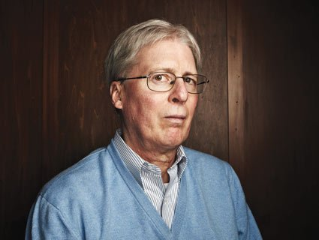
Notes:
Mark, see this http://www.stat.columbia.edu/~gelman/presentations/cuips_presentation.pdf

Slide 4
Prior Work
On state level campaign finance:
Barber 2016, Hamm and Hogan 2008; Primo and Milyo 2006
On state level corruption:
Alt and Lassen 2006, Walker and Calcagno 2011, Liu & Mikesell 2014, Glaeser and Saks 2006, Crider and Milyo 2013, Boylan and Long 2003, Dincer 2018
On state level campaign finance and corruption
Cordis and Milyo 2013

Slide 5
Question
Are campaign contribution limits at the state level correlated with lower levels of political corruption?

Slide 6
Data
IVs: State Level Campaign Contribution Limits
Individual-to-campaign / PAC-to-campaign / Individual-to-party
Source: Michael Barber
DVs: Corruption
Corruption Convictions Index (CCI) and Corruption Reflections Index (CRI)
Source: Institute for Corruption Studies
Controls
Source: James Alt

Slide 7
Design(s)
Panel
Two-way fixed effects
Controls
Dummy variables for each type of limit
1990-2004
First Differences
Increase, decrease, imposition and removal
1990-2012

Slide 8
Results
1990-2004 panel model
No correlation with convictions index
One correlation with reflections index?
1990-2012 first differences model
No correlation with convictions index
No correlation with reflections index

Slide 9
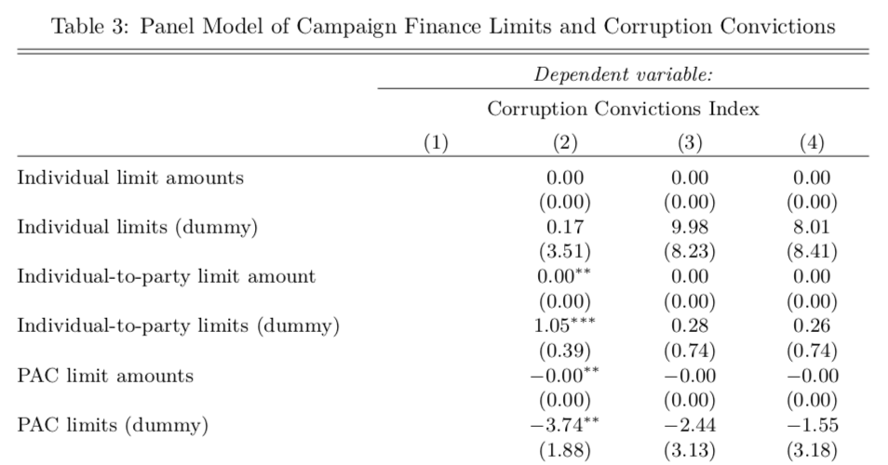
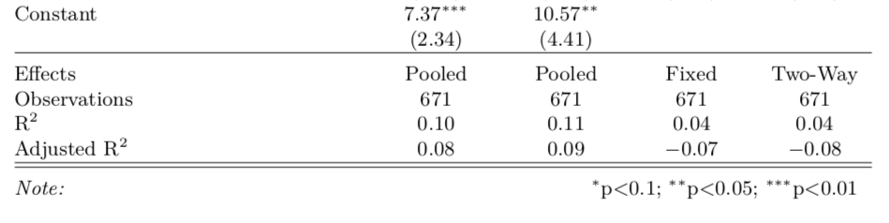
[Controls omitted]

Slide 10
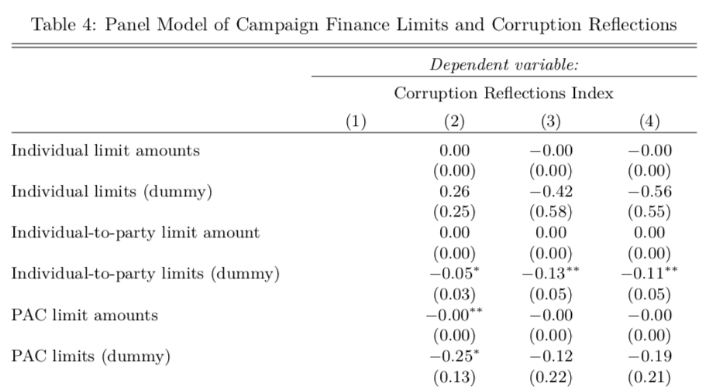
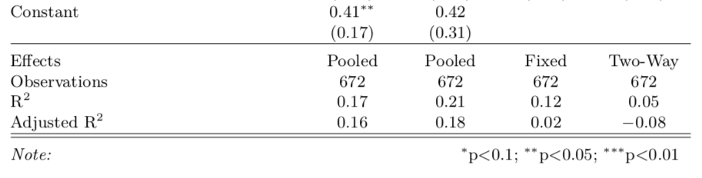
[Controls omitted]

Slide 11
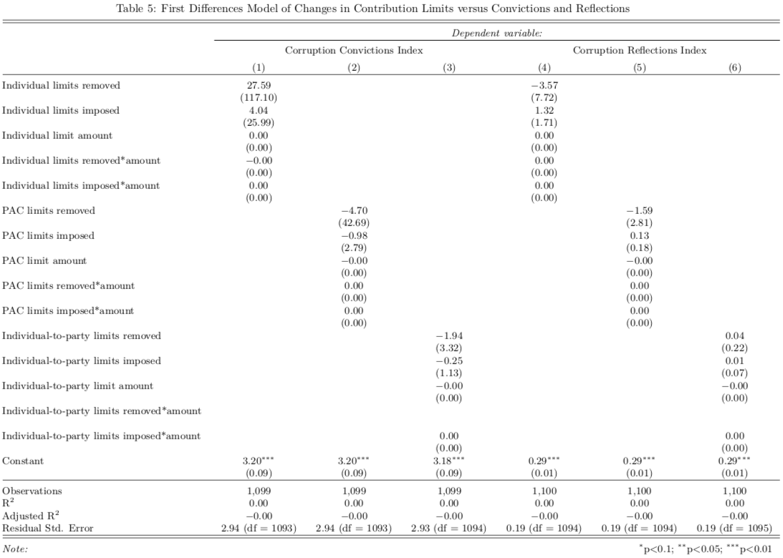

Slide 12
Discussion
Alternative explanations
Limitations

Slide 13
Notes:
Mark, see this http://www.stat.columbia.edu/~gelman/presentations/cuips_presentation.pdf

Slide 14
January 2019
Thank You!
Campaign Contribution Limits and Corruption: Evidence from the 50 states
Mark Clayton Hand
PhD Student, The University of Texas at Austin • @markchand • mark.hand@utexas.edu

